Slide 1
Cathy Sutherlin Final Project Stat 824
Forest Fire
Data Set

Slide 2
Forest Fire Data Set
This data was located in the Kaggle dataset website and was used with data mining techniques to predict forest fires with meteorological data[Cortez and Morais, 2007]*. The data was gathered in Portugal during the dramatic fire seasons in 2003 and 2005.
The best configuration uses a SVM model and the four meteorological components of temperature, relative humidity, rain and wind as was most effective in predicting the burned areas of small fires.
P. Cortez and A. Morais. A Data Mining Approach to Predict Forest Fires using Meteorological Data. In J. Neves, M. F. Santos and J. Machado Eds., New Trends in Artificial Intelligence, Proceedings of the 13th EPIA 2007 - Portuguese Conference on Artificial Intelligence, December, Guimaraes, Portugal, pp. 512-523, 2007. APPIA, ISBN-13 978-989-95618-0-9. Available at: http://www.dsi.uminho.pt/~pcortez/fires.pdf

Slide 3

Variables in the Data Set
X - x-axis spatial coordinate within the Montesinho park map: 1 to 9
Y - y-axis spatial coordinate within the Montesinho park map: 2 to 9
month - month of the year: 'jan' to 'dec'
day - day of the week: 'mon' to 'sun'
FFMC - FFMC index from the FWI system: 18.7 to 96.20
DMC - DMC index from the FWI system: 1.1 to 291.3
DC - DC index from the FWI system: 7.9 to 860.6
ISI - ISI index from the FWI system: 0.0 to 56.10
temp - temperature in Celsius degrees: 2.2 to 33.30
RH - relative humidity in %: 15.0 to 100
wind - wind speed in km/h: 0.40 to 9.40
rain - outside rain in mm/m2 : 0.0 to 6.4
area - the burned area of the forest (in ha(hectare): 0.00 to 1090.84 (this output variable is very skewed towards 0.0, thus it may make sense to model with the logarithm transform).

Slide 4
FFMC – Fine Fuel Moisture code: represents fuel moisture of forest litter under the shade of the forest canopy. DMC – Duff Moisture Code: represents fuel moisture of decomposed organic material underneath the litter. DC – Drought Code: represents drying deep into the soil and approximates for the equivalent of a 53 day timelag fuels. ISI – Initial Spread Index: integrates fuel moisture for fine dead fuels and surface windspeed to estimate spread potential.
FWI fuel moisture codes and fire behavior indices used in data.

Slide 5
Additional Data Information
Most of the data is numerical outside of the month and day of the week. The the burned area of the forest is measured in (in ha) with a range of 0.00 to 1090.84. This output variable is very skewed towards 0.0, thus it may make sense to model with the logarithm transform. I am interested in the meteorological variables of the data, particularly temperature, and how these variables correlate to all the other data and the model.

Slide 6
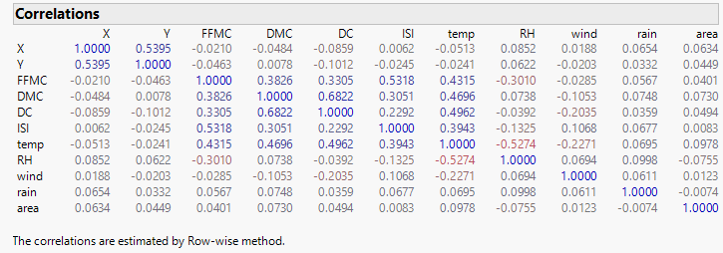
Priniciple Component Analysis and Correlation
The correlation matrix shows that temperature has a small correlation to the burn area but, it is the most correlated of all the variables. However, temperature shows some other stronger correlations to other variables.

Slide 7
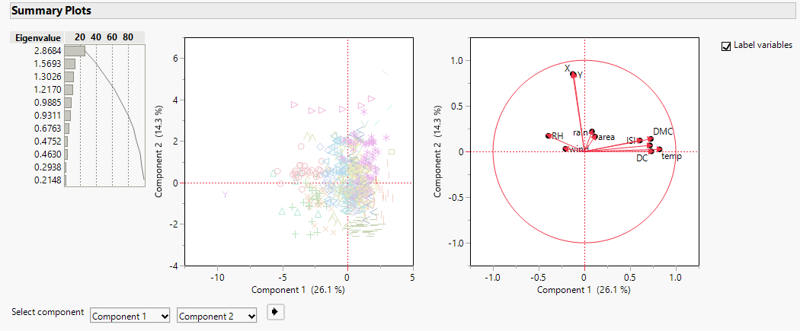
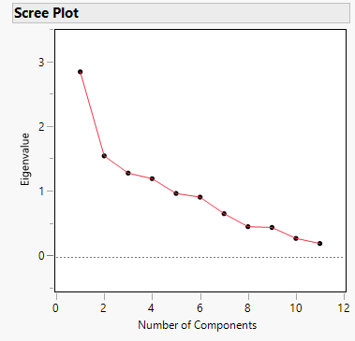
Principle Component Analysis
A principle component analysis can be a predictive tool so I am choosing to look at these components. We really want to be able to reduce some of the variables but looking at the scree plot and the percentages more components would be needed. This is very complex set of data.

Slide 8
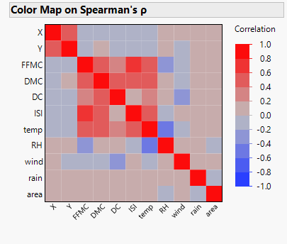
Color Map using Spearmans Correlation
A color map using Spearman’s method illustrates some interesting correlations with temperature and other variables especially the Fire Weather Indices.

Slide 9
Link to Github with Interactive Scatterplot
Here is a link to a Shiny app in Github that has an interactive scatterplot with all the variables in the data. It is very interesting to see the associations with the individual variables to each other as well as to the size of burn area.
https://github.com/csutherlin/Forest-Fire-Data
You can also copy and past this command in source code area of R and run it there.
Library(shiny)
runGitHub(repo = "Forest-Fire-Data",username = "csutherlin", ref="main")

Slide 10
In Conclusion
In conclusion, none of the variables had a strong correlation to the burn area. Temperature had the strongest but had stronger correlations to the other variables. Some reduction or combining of variables could be considered with the stronger correlated variables Many of the components would be needed to make a prediction model. The article mentioned that several data mining techniques and Support Vector Machines with all the variables were used to create a predictive model(Cortez and Morsais 2007). The next step would be look at data outside of Portugal as California and Colorado would most likely have some great data.

Slide 11
References
P. Cortez and A. Morais. A Data Mining Approach to Predict Forest Fires using Meteorological Data. In J. Neves, M. F. Santos and J. Machado Eds., New Trends in Artificial Intelligence, Proceedings of the 13th EPIA 2007 - Portuguese Conference on Artificial Intelligence, December, Guimaraes, Portugal, pp. 512-523, 2007. APPIA, ISBN-13 978-989-95618-0-9. Available at: http://www.dsi.uminho.pt/~pcortez/fires.pdf
v

